Slide 1
Basic Electrical and Electronics Engineering
Dr. Sonam Shrivastava/ Assistant Professor (Sr.) /SELECT
LECTURE 1.4

Slide 2
Voltage Division
The percentage of the total voltage associated with a particular resistor is equal to the percentage that the resistor contributed to the equivalent resistance, R_{eq}.
The largest value resistor has the largest voltage.

Slide 3
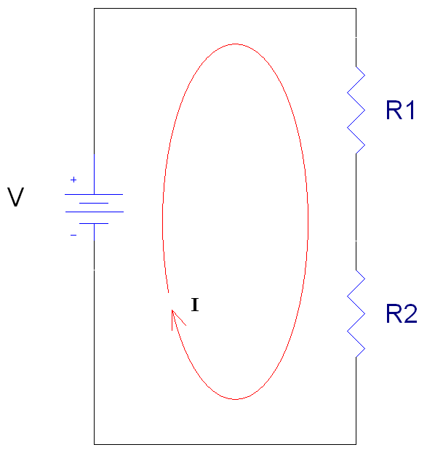
Voltage Dividers
Resistors in series share the same current
Vin

Slide 4
Voltage Dividers
Resistors in series share the same current
From Kirchoff’s Voltage Law and Ohm’s Law :
+
V1
-
+
V2
_
Vin

Slide 5
Voltage Dividers
Resistors in series share the same current
From Kirchoff’s Voltage Law and Ohm’s Law :
+
V1
-
+
V2
_
Vin

Slide 6
Voltage Division
The voltage associated with one resistor R_{n} in a chain of multiple resistors in series is:
or
where V_{total} is the total of the voltages applied across the resistors.

Slide 7
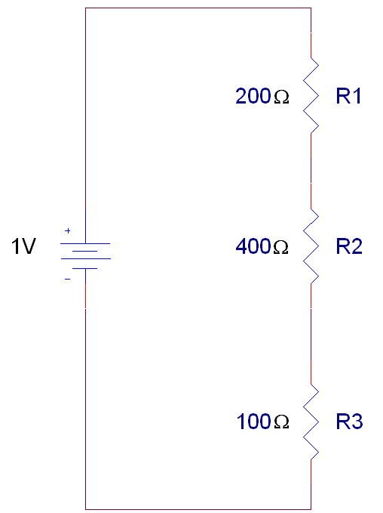
Example 1
+
V1
-
+
V2
-
+
V3
-
Find the voltages listed in the
circuit to the right.

Slide 8
Example 1 (con’t)
+
V1
-
+
V2
-
+
V3
-
Check: V1 + V2 + V3 = 1V

Slide 9
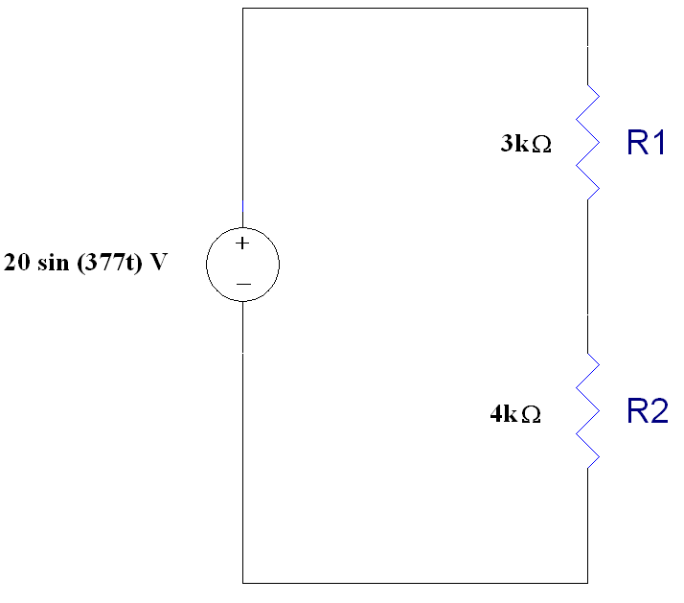
Example 2
Voltage across R1 is:
Voltage across R2 is:
Check: V1 + V2 should equal Vtotal
+
V1
-
+
V2
_
8.57 sin(377t)V + 11.4 sin(377t) = 20 sin(377t) V

Slide 10
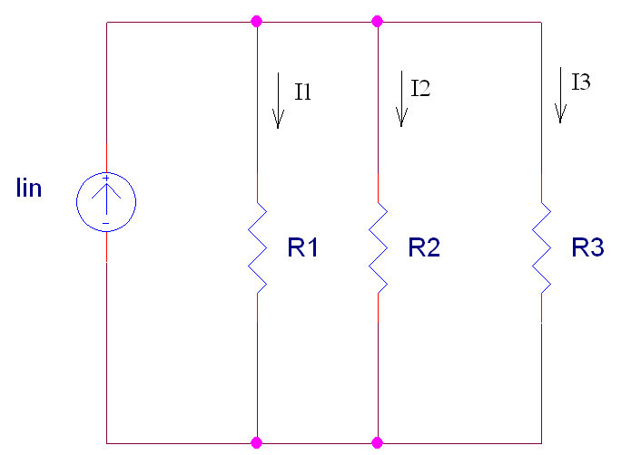
Symbol for Parallel Resistors
To make writing equations simpler, we use a symbol to indicate that a certain set of resistors are in parallel.
Here, we would write
R1║R2║R3
to show that R1 is in parallel with R2 and R3. This also means that we should use the equation for equivalent resistance if this symbol is included in a mathematical equation.

Slide 11
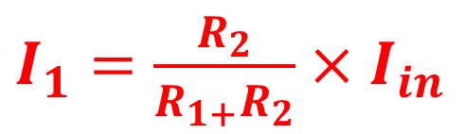
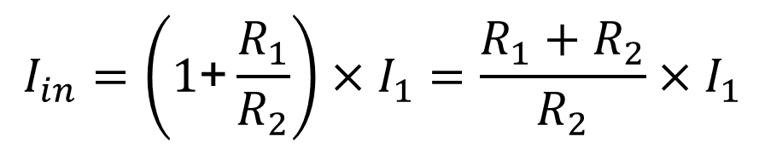



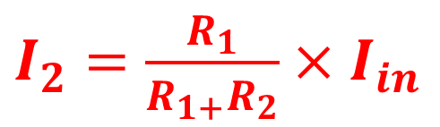
Current Division
All resistors in parallel share the same voltage
$I_{in}=I_{1}$+$I_{2}$
$$I_{2}=\frac{R_{1}}{R_{2}}×I_{1}$$
+
V_{in}
_
$$V_{in}=I_{1}R_{1}=I_{2}R_{2}$$
$$I_{in}=\left(1\text{+}\frac{R_{1}}{R_{2}}\right)×I_{1}=\frac{R_{1}+R_{2}}{R_{2}}×I_{1}$$
$I_{1}$ $=\frac{R_{2}}{R_{1+}R_{2}}×I_{in}$
$I_{2}$ $=\frac{R_{1}}{R_{1+}R_{2}}×I_{in}$

Slide 12
Current Division
All resistors in parallel share the same voltage
+
V_{in}
_

Slide 13
Current Division
All resistors in parallel share the same voltage
From Kirchoff’s Current Law and Ohm’s Law :
+
V_{in}
_

Slide 14
Current Division
All resistors in parallel share the same voltage
+
V_{in}
_

Slide 15
Current Division
Alternatively, you can reduce the number of resistors in parallel from 3 to 2 using an equivalent resistor.
If you want to solve for current I1, then find an equivalent resistor for R2 in parallel with R3.
+
V_{in}
_

Slide 16
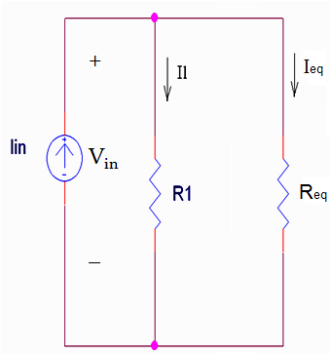
Current Division
+
V_{in}
_

Slide 17
Current Division
The current associated with one resistor R₁ in parallel with one other resistor is:
The current associated with one resistor R_{m} in parallel with two or more resistors is:
where I_{total} is the total of the currents entering the node shared by the resistors in parallel.

Slide 18
Current Division
The largest value resistor has the smallest amount of current flowing through it.

Slide 19
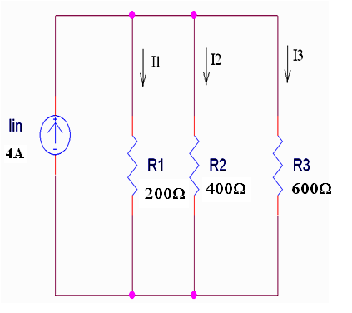
Example 3
Find currents I1, I2, and I3 in the circuit to the right.

Slide 20
Example 3 (con’t)
Check: I1 + I2 + I3 = Iin

Slide 21
Summary
The equations used to calculate the voltage across a specific resistor R_{n} in a set of resistors in series are:
The equations used to calculate the current flowing through a specific resistor R_{m} in a set of resistors in parallel are:

Slide 22


What is the current through and voltage across 5 ohm resistor?
+
V
-
I = 20/5 = 4 A
I
V = 20 V

Slide 23

Find I and V
= 5 +15 =20 Ω

Slide 24
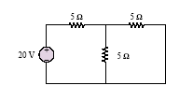
Find I₁,I₂ and V
= 5 +2.5 =7.5Ω
I₁
I₂
I₂ by current division rule

Slide 25

Find I₁,I₂ and V
= 5 +1.875
= 6.875Ω
I₂
I₁
I₂ by current division rule
Current thro’ 3 ohm
I₃ = I₁ – I₂ = 2.91-1.09 = 1.82A

Slide 26

A source e.m.f. of 5 V supplies a current of 3 A for 10 minutes. How much energy is provided in this time?
Solution

Slide 27
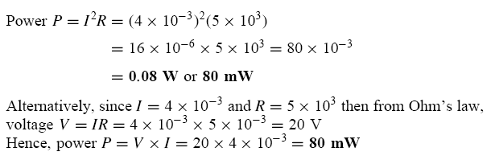
Solution

Slide 28

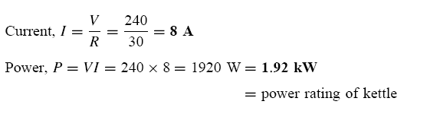
Solution

Slide 29

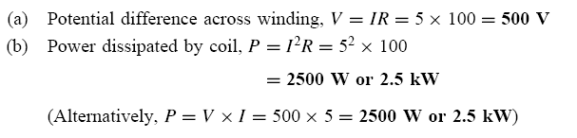

Slide 30
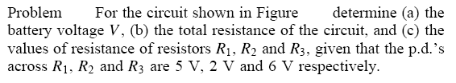
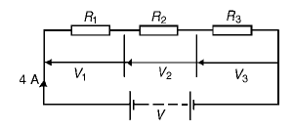

Slide 31
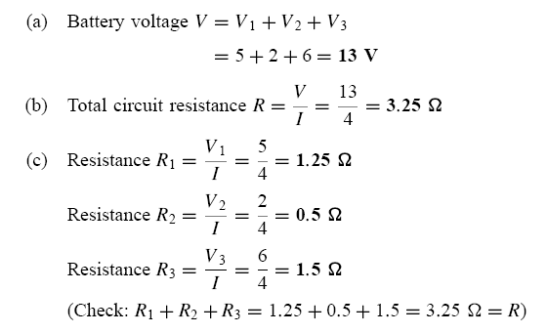
Solution

